Slide 1
Q2 2024
Earnings and Business Update Call
August 13, 2024

Slide 2
Disclaimers
This presentation contains forward-looking statements that discuss expectations as to future trends, plans, events, results of operations or financial condition, or state other information relating to Sanara MedTech Inc. (the “Company,” “Sanara,” “we,” “our” or “us”). All statements other than statements of historical fact contained herein are forward-looking statements. These statements may be identified by terms such as “aims,” “anticipates,” “believes,” “contemplates,” “continue,” “could,” “estimates,” “expect,” “forecast,” “guidance,” “intend,” “may,” “plan,” “possible,” “potential,” “predicts,” “preliminary,” “projects,” “seeks,” “should,” “targets,” “will,” or “would,” or the negatives of these terms, variations of these terms or other similar expressions. These forward-looking statements include, among others, statements concerning the intended use of net proceeds from the CRG facility, the efficacy of the InfuSystem partnership, the efficacy of BIASURGE, the development and launch of new products, the timing of commercialization of our products, the regulatory approval process and expansion of the Company’s business in telehealth and wound care. These items involve risks, contingencies and our ability to identify and consummate synergistic transactions, our ability to build out our executive team, our ability to identify and effectively utilize the net proceeds of the CRG term loan to support the Company’s growth initiatives, the development and process for obtaining regulatory approval for new products, the extent of product demand, market and customer acceptance, the effect of economic conditions, competition, pricing, the ability to consummate and integrate acquisitions, and other risks, contingencies and uncertainties detailed in the Company’s filings with the Securities and Exchange Commission (“SEC”), including the Company’s most recently filed Annual Report on Form 10-K and the Company’s Quarterly Reports on Form 10-Q as well as other documents the Company files with the SEC. Investors and security holders are urged to read these documents free of charge on the SEC’s website at http://www.sec.gov. Forward-looking statements contained in this presentation are made as of this date, and the Company undertakes no obligation to publicly update any forward-looking statement, whether as a result of new information, future events, or otherwise, except as required by applicable securities laws.
This presentation contains statistical and market data that we obtained from industry publications, reports generated by third parties, third-party studies and public filings. Although we believe that the publications, reports, studies and filings are reliable as of the date of this presentation, we have not independently verified such statistical or market data.
The trademarks and service marks included herein are the property of the owners thereof and are used for reference purposes only. Such use should not be construed as an endorsement of such products.
This presentation shall not constitute an offer to sell or the solicitation of an offer to buy securities, nor shall there be any sales of securities, in any state or jurisdiction in which such an offer, solicitation, or sale would be unlawful prior to registration or qualification under the securities laws of any such state or jurisdiction.
CAUTION: This presentation concerns certain products that are under clinical investigation, which have not yet been cleared for marketing by the U.S. Food and Drug Administration. These products are currently limited by federal law to investigational use, and no representation is made as to the safety or effectiveness of these products for the purposes for which they are being investigated.

Slide 3

Executive Summary
Financial Update (Unaudited)
  Highest net revenue quarter in the Company’s history ($20.2 million)
    Eleventh consecutive record revenue quarter
  Net loss of $3.5 million in Q2
  Adjusted EBITDA⁽¹⁾ of $0.6 million in Q2
Non-Core Operations Expenses in Q2
  Prior CEO separation costs ($0.9 million)
  Legal and diligence costs for potential acquisitions in progress ($0.4 million)
Core Surgical Business (Excluding THP)
  Segment net loss of $2.2 million in Q2 and $2.7 million in 1H.
  Segment EBITDA ⁽¹⁾ of $1.4 million in Q2 and $2.5 million in 1H.
Tissue Health Plus Expansion
  Expect to invest an additional $4.0-5.0 million in 2H of 2024 to continue to build this strategy.
Adjusted EBITDA and Segment EBITDA are non-GAAP financial measures. See the discussion and reconciliation in the appendix for additional information.

Slide 4
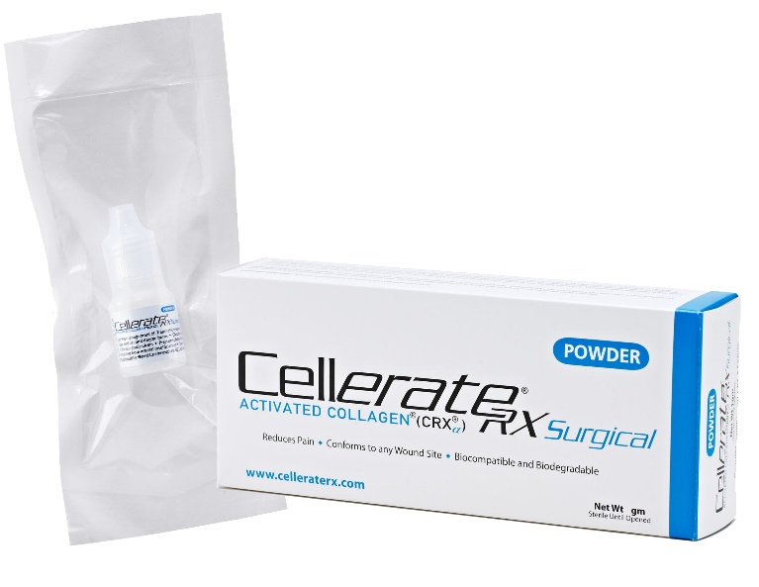
Surgical Sales
Sales Overview (Unaudited)
Sanara products were sold in over 1,100 hospitals/ASCs across 34 states plus the District of Columbia⁽¹⁾ in the TTM ended June 30, 2024.
Sanara products were contracted or approved to be sold in more than 4,000 hospitals/ASCs as of June 30, 2024.
300+ distributors (+70 since Jan 2024) with 2,500+ potential sellers (+400 since Jan 2024).
Sold into 800+ facilities in Q2 2024 (a quarterly record) compared to 600+ in Q2 2023.
Sales of soft tissue repair products were $17.6 million in the second quarter of 2024 (CellerateRX®, FORTIFY TRG® Tissue Repair Graft, FORTIFY FLOWABLE® Extracellular Matrix, BIASURGE ®, and TEXAGEN® Amniotic Membrane Allograft) compared to $13.2 million in the second quarter of 2023.
Sales of bone fusion products were $2.5 million in the second quarter of 2024 (BiFORM® Bioactive Moldable Matrix, ACTIGEN™ Verified Inductive Bone Matrix, and ALLOCYTE® Advanced Cellular Bone Matrix) compared to $2.5 million in the second quarter of 2023.
Based on a minimum of $50,000 revenue in the TTM.

Slide 5
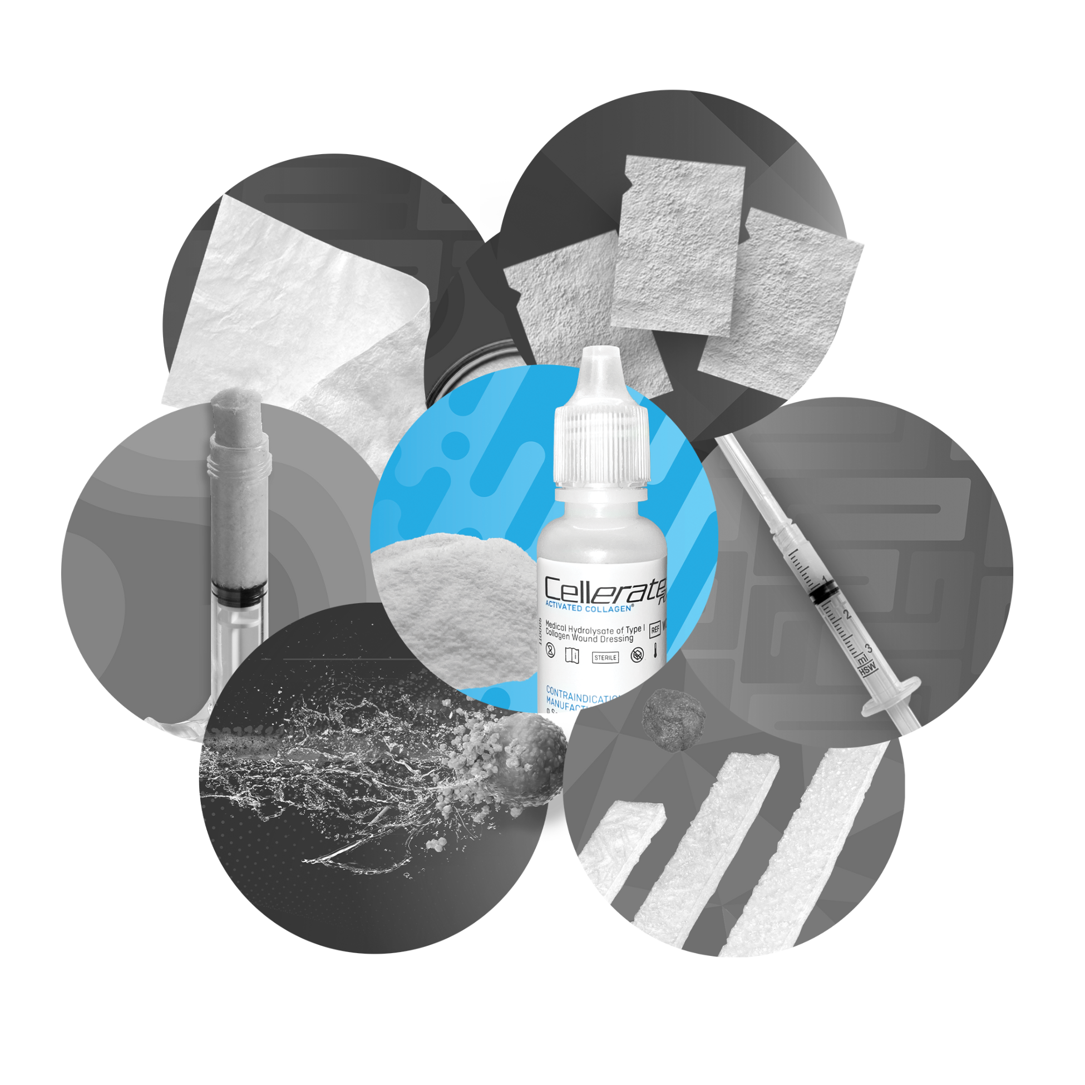
Surgical Growth Opportunities
Additional Facility Approvals
Recently executed a contract with a national GPO giving SMTI sales team access to an additional 1,000+ facilities.
Team is working to further penetrate existing facilities while also generating sales in new facilities.
Additional Specialty Focus
The majority of CellerateRX® cases have been in the Ortho and Spine specialties.
The Company is implementing surgical strategy to further penetrate additional specialties including trauma, vascular, and general surgery.
Inorganic Growth Opportunities
Management anticipates synergistic potential transactions as a key growth driver that complements strong organic growth.
Company is currently pursing multiple surgical M&A and partnership opportunities to complement its existing portfolio.

Slide 6
Operational Alignment
Reorganized operations team to centralize ownership and accountability across all aspects of customer support, product fulfillment, and underlying IT system infrastructure.
IT/Infrastructure
Building out IT Roadmap focused on workflow automation and digital support for next phase of growth.
Sales Operations
Implementing plans to efficiently scale our customer service team and simplifying the selling process for both internal and external sales representatives.
Shipping and Fulfillment
With the significant growth experienced by the Company, Sanara is working to separate and streamline its shipping and fulfillment operations to allow customer service to focus on best of class sales support.
Supply Chain
Reorganized supply chain function to facilitate smooth and consistent operations across all product lines.

Slide 7
Tissue Health Plus

Slide 8
Wound Care Represents $100B+ Yearly Spend (Products + Services) But Generates Mixed Patient Outcomes
$100B+⁽¹⁾
U.S. Annual Spend on Products & Services Across Care Settings
~$69B+⁽¹⁾
Occurs in the Highest Cost Setting, the Hospital
~$35B+
Of the Spend is either Preventable or is Overuse and Wastage
30%+⁽³⁾
U.S. 5 Year Diabetic Foot Ulcer Patient Mortality, Same As Cancer Patient’s
40-66%⁽²⁾
U.S. Chronic Wound Healing Rate
15%+⁽¹⁾
Of 65+ U.S. Population Has Chronic Non-Healing Wounds
Opportunity
Reduce hospital spend by realigning home & community based wound care (physician offices, skilled nursing homes)
THP Analysis + Carter MJ, DaVanzo J, Haught R, et al. Chronic wound prevalence and the associated cost of treatment in Medicare beneficiaries: Changes between 2014 and 2019. J Med Econ 2023;26(1): 894–901; doi: 10.1080/13696998.2023.2232256
National US Wound Center healing rates > 90% exclude those with multi conditions and more severe wounds (Fife, Eckert) National US Wound Center healing rates > 90% exclude those with multi conditions and more severe wounds (Fife, Eckert)
Sheets, AR, Hwang, C and IM Herman 2016. Developing Smart Point-of-Care Diagnostic Tools for “Next-Generation” Wound Care In Translating Regenerative Medicine to the Clinic. http://dx.doi.org/10.1016/B978-0-12-800548-4.00017-6. Copyright © 2016 Elsevier Inc. IM Herman. 2016 Translating Regenerative Medicine to the Clinic
Wound Care is a large unmanaged spend segment that is ripe for disruption. It is strongly correlated to the growing obesity and chronic disease epidemic. 50M+ wounds by 2050
Notes:
Sam , commentary from JM JR depending on interaction

Slide 9







Our Program is Designed to Align Patients, Payors And Providers To Deliver Compelling Value
Connected Payor
Aligned Value Delivery
Programs Tailored For Payor’s Specific Population
Accrual Of Hospital Based Savings (>20%) To Payor
Payor Net Savings 2X to 5X THP Fees
Two–Way Integration
Complete Performance & Engagement Transparency
Engaged Patient
NPs
Performant Network
LVNs
RNs
THP Care Hub: Hands On Orchestrator
Engagement For Care Plan Adherence
Targeting >25% Prevention + 90% Healing Rate
Accessible & Consistent Care Navigation
360 Degree Interactive Care Plan
SDOH & Community Integration Support
Tissue Health Index Score Driven Incentives
Self-Care & Reporting Enablement
THP SOC Driven Care Transformation
New Revenue & EBITDA Opportunities
Real Time Clinical Decision Support
No Need To Switch Current EMR
Practice & Network Leader Board
Quality Incentives
Path To Quality Guidance
THP INTEGRATED CARE MODEL (Prevention +Treatment + Maintenance)
THP VBC SCALER PLATFORM
Notes:
SAM

Slide 10
Q2 2024 Financial Highlights (Unaudited)
Revenue
  For the three months ended June 30, 2024, Sanara generated net revenue of $20.2 million compared to net revenue of $15.8 million for the three months ended June 30, 2023, a 28% increase from the prior year period.
  The higher net revenue for the three months ended June 30, 2024 was primarily due to increased sales of soft tissue repair products, including CellerateRX, as a result of our increased market penetration, geographic expansion, and our continuing strategy to expand our independent distribution network in both new and existing U.S. markets.
SG&A
  SG&A expenses for the three months ended June 30, 2024 were $19.0 million compared to SG&A expenses of $13.8 million for the three months ended June 30, 2023.
  SG&A expenses included $0.6 million and $0.5 million attributable to our THP segment for the three months ended June 30, 2024 and 2023, respectively.
  The higher SG&A expenses for the three months ended June 30, 2024 were primarily due to higher direct sales and marketing expenses, which accounted for approximately $3.4 million of the increases compared to the prior year period.
  SG&A expenses during the second quarter of 2024 also included $0.9 million of separation costs related to our former Chief Executive Officer, and $0.4 million of legal and diligence expenses related to certain prospective acquisitions.
R&D Expenses
  R&D expenses for the three months ended June 30, 2024 were $1.0 million compared to R&D expenses of $1.2 million for the three months ended June 30, 2023.

Slide 11
Q2 2024 Financial Highlights (Continued)
R&D Expenses (continued)
  R&D expenses included $0.4 million and $1.0 million attributable to our THP segment for the three months ended June 30, 2024 and 2023, respectively.
  The lower R&D expenses for the three months ended June 30, 2024 compared to the three months ended June 30, 2023 were primarily due to lower costs associated with the Precision Healing diagnostic imager and LFA.
Depreciation, Amortization and Interest Expense
  Depreciation and amortization expenses for the three months ended June 30, 2024 were $1.1 million compared to $0.8 million for the same period in 2023. The higher depreciation and amortization expenses in 2024 were due to amortization of intangible assets acquired from Applied Nutritionals in August 2023.
  Interest expense was $0.6 million for the three months ended June 30, 2024 compared to zero during Q2 2023. The higher interest expense in 2024 was primarily related to our new term loan with CRG.
Net Loss
  Sanara had a net loss of $3.5 million for the three months ended June 30, 2024, compared to a net loss of $1.9 million for the three months ended June 30, 2023.
  The net loss included $1.3 million and $2.0 million attributable to our THP segment for the three months ended June 30, 2024 and 2023, respectively
  The higher net loss for the three months ended June 30, 2024 was primarily due to higher SG&A costs, higher interest expense related to our new CRG Term Loan, a lower change in fair value of earnout liabilities and higher amortization of our acquired intangible assets as discussed above, partially offset by higher gross profit and lower R&D expenses.
Cash Balances at End of Quarter (in millions)
  $6.1 (Q2-23), $6.2 (Q3-23), $5.1 (Q4-23), $2.8 (Q1-24), $6.2 (Q2-24)

Slide 12
Segment Reporting
Segment Reporting Overview
  Break out of Tissue Health Plus and Sanara Surgical to inform the investor community of our strategic rationale of the acute/post acute comprehensive strategy investments.
Three Months Ended June 30, 2024
 | Surgical | THP | Total
Net Revenue | $20.2 | - | $20.2
Net loss | $(2.2) | $(1.3) | $(3.5)
Segment EBITDA / Adjusted EBITDA (consolidated)⁽¹⁾ | $1.4 | $(0.8) | $0.6
Three Months Ended June 30, 2023
 | Surgical | THP | Total
Net Revenue | $15.8 | - | $15.8
Net income (loss) | $0.1 | $(2.0) | $(1.9)
Segment EBITDA / Adjusted EBITDA (consolidated)⁽¹⁾ | $1.1 | $(1.4) | $(0.3)
Six Months Ended June 30, 2024
 | Surgical | THP | Total
Net Revenue | $38.7 | - | $38.7
Net loss | $(2.7) | $(2.6) | $(5.3)
Segment EBITDA / Adjusted EBITDA (consolidated)⁽¹⁾ | $2.5 | $(1.6) | $0.9
Six Months Ended June 30, 2023
 | Surgical | THP | Total
Net Revenue | $31.3 | - | $31.3
Net income (loss) | $0.6 | $(3.7) | $(3.1)
Segment EBITDA / Adjusted EBITDA (consolidated)⁽¹⁾ | $2.4 | $(3.0) | $(0.6)
Adjusted EBITDA and Segment EBITDA are non-GAAP financial measures. See the discussion and reconciliation in the appendix for additional information.

Slide 13
CRG Facility
Strategic Rationale
Non-dilutive to equity holders and it provides growth/acquisition capital as well as strengthens our cash position.
Flexible capital that can be drawn at the Company’s option.
Allows for Sanara to enter into a separate $10.0 million revolver backed by A/R and inventory.
Term Loan Overview
$55 Million in aggregate potential proceeds structured as a senior secured term loan with a five-year term
$15 million drawn at close
Up to $39.8 million available as of June 30, 2024, at Sanara’s option, to be drawn before June 30th, 2025

Slide 14
Questions

Slide 15
Appendix

Slide 16
Non-GAAP Financial Measure
Use of Non-GAAP Financial Measure
To supplement the Company’s financial information presented in accordance with generally accepted accounting principles in the United States (“GAAP”), we present certain non-GAAP financial measures in this press release and on the related teleconference call, including Adjusted EBITDA and Segment EBITDA. The Company’s management uses these non-GAAP financial measures, both internally and externally, to assess and communicate the financial performance of the Company. The Company defines Adjusted EBITDA as net loss excluding interest expense/income, provision/benefit for income taxes, depreciation and amortization, non-cash share-based compensation expense, change in fair value of earnout liabilities, effects of noncontrolling interests, executive separation costs, legal and diligence expenses related to acquisitions and gains/losses from the disposal of property and equipment, as each is applicable to the periods presented. The Company’s believes Adjusted EBITDA and Segment EBITDA are useful to investors because they facilitate comparisons of its core business operations across periods on a consistent basis. Accordingly, the Company adjusts for items such as change in fair value of earnout liabilities when calculating Adjusted EBITDA and Segment EBITDA because the Company believes that they are not related to the Company’s core business operations. Segment EBITDA is calculated in the same manner as Adjusted EBITDA but is presented on a segment basis.
The Company’s non-GAAP financial measures are not in accordance with, nor an alternative for, measures conforming to GAAP and may be different from non-GAAP financial measures used by other companies. In addition, these non-GAAP financial measures are not based on any comprehensive set of accounting rules or principles. The Company continues to provide all information required by GAAP, but it believes that evaluating its ongoing operating results may not be as useful if an investor or other user is limited to reviewing only GAAP financial measures. The Company does not, nor does it suggest that investors should, consider these non-GAAP financial measures in isolation from, or as a substitute for, financial information prepared in accordance with GAAP. Material limitations associated with the use of such measures include that they do not reflect all costs included in operating expenses and may not be comparable with similarly named financial measures of other companies. Furthermore, these non-GAAP financial measures are based on subjective determinations of management regarding the nature and classification of events and circumstances. The Company presents these non-GAAP financial measures to provide investors with information to evaluate the Company’s operating results in a manner similar to how management evaluates business performance. To compensate for any limitations in such non-GAAP financial measures, management believes that it is useful in understanding and analyzing the results of the business to review both GAAP information and the related non-GAAP financial measures. Whenever the Company uses a non-GAAP financial measure, it provides a reconciliation of the non-GAAP financial measure to the most directly comparable GAAP financial measure. Investors are encouraged to review and consider these reconciliations.
Segment EBITDA is reported to the chief operating decision maker for purposes of making decisions about allocating resources to the segments and assessing their performance.

Slide 17
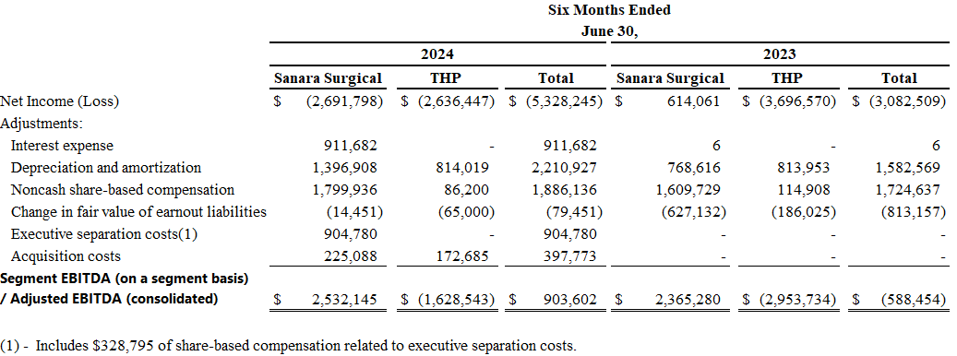
Reconciliation of GAAP to Non-GAAP Financial Measures (Consolidated)

